Slide 1
Creating a Geospatial Macro Level Feature Database Final Presentation
Jason Brewer
Notes:
76 data points
average time complexity O(n log n)
O(n) memory - pyclustering

Slide 2

Recap
The Siloam system aims to provide a data collection and analysis platform to assist BoVI users in their exploration of new outdoor areas
Comprised of three parts:
Google Project Tango powered raw data collection app (SiloamSee)
Offline machine learning component (SiloamLearn)
Couchbase server powered online database (SiloamSilo)

Slide 3
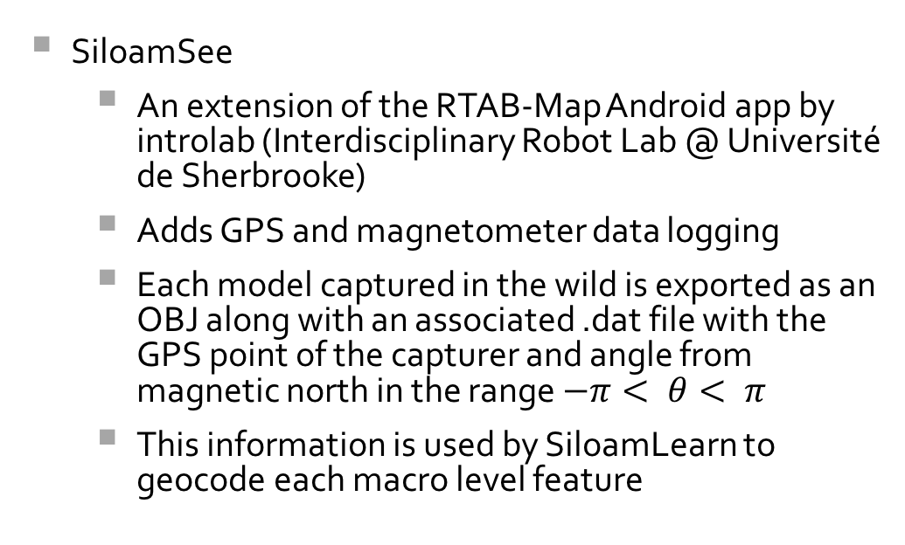
Outputs
SiloamSee
An extension of the RTAB-Map Android app by introlab (Interdisciplinary Robot Lab @ Université de Sherbrooke)
Adds GPS and magnetometer data logging
Each model captured in the wild is exported as an OBJ along with an associated .dat file with the GPS point of the capturer and angle from magnetic north in the range $−π< θ< π$
This information is used by SiloamLearn to geocode each macro level feature

Slide 4
Data collection points

Slide 5
GPS inaccuracy

Slide 6
Data preparation: OBJ to RGB-D
The transition is completed via Python scripting in Blender, an open source 3D modelling application
Generates RGB-D from SiloamSee models automatically
Generating RGB-D data from Trimble Warehouse DAE models is a more interactive process

Slide 7
Outputs
SiloamLearn
Prepares the data for the SVM using:
libpng
OpenCV
pyclustering (despite the name it is also a C++ library)
The idea is that the SVM will be trained to detect four categories of feature from the RGB-D dataset:
Bus stop
Crossing
Doorway
Steps

Slide 8
Floor Removal

Slide 9
Evaluation
MoSCoW
Data collection and preparation 👍
Machine learning – very close to completion but experimentation with image segmentation required 👎

Slide 10
Further demonstration?

